Slide 1
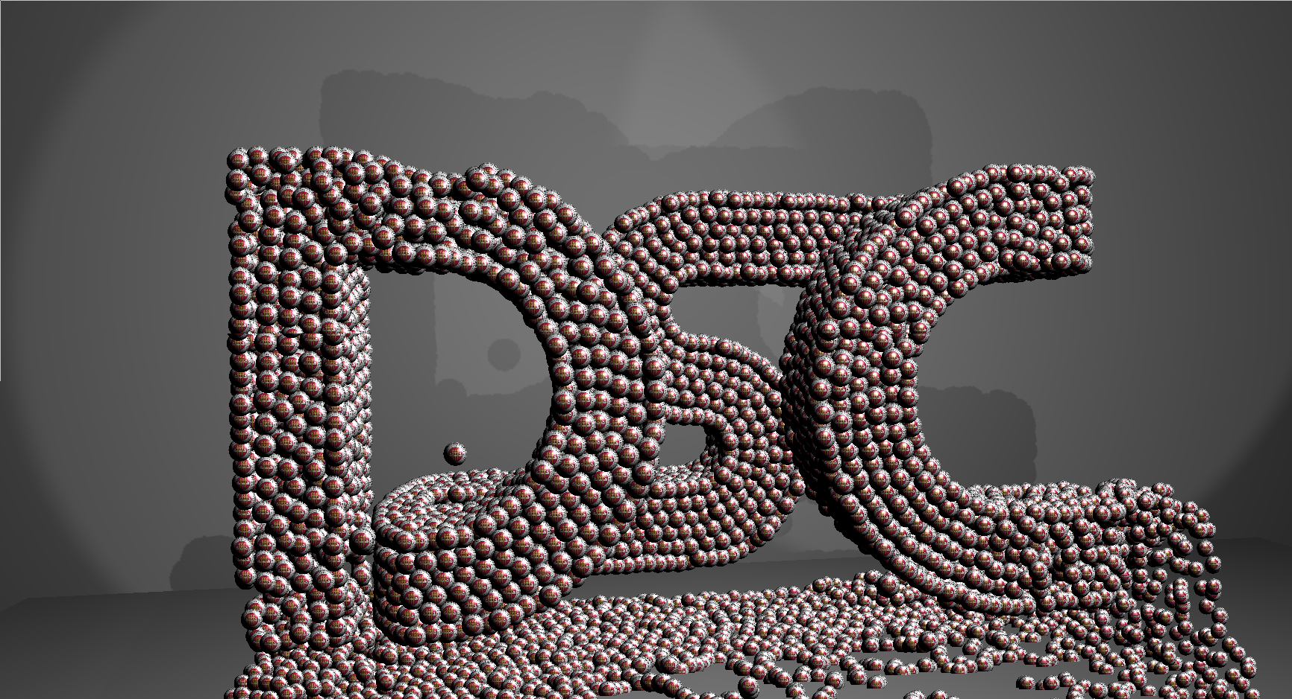


Multi-GPU Solutions of Geophysical PDEs with Radial Basis Function-generated Finite Differences
Evan F. Bollig
Nov 6th, 2013
499 DSL, 4:30 pm – 6:30 pm

Slide 2

Acknowledgements
This work is supported in part by NSF awards DMS-#0934331 (FSU), DMS-#0934317 (NCAR) and ATM-#0602100 (NCAR).
Computational resources provided by:
Keeneland Computing Facility at the Georgia Institute of Technology (NSF Contract OCI-0910735)

Slide 3
Investigation Focus
Notes:
Topics covered in this defense: a) the application of a recent numerical method (barely cuts into the numerical method domain. b) a distributed implementation of RBF-FD that runs on multi-GPUs (heavy into the hardware and software). c) neighbor query algorithm (software)

Slide 4
Overview
Preliminaries
Introduction to GPUs
Introduction to RBF-FD
Code Verification Details
A Fixed-Grid Method for RBF Methods
Space Filling Curves and Node Ordering
Lasting Impacts on Performance
Single GPU RBF-FD
Targeting Multi-GPU Clusters
MPI Tuning
Overlapping Communication and Computation
Conclusions
Notes:
Introduction to RBF methods (beyond RBF-FD)?

Slide 5
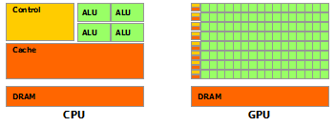
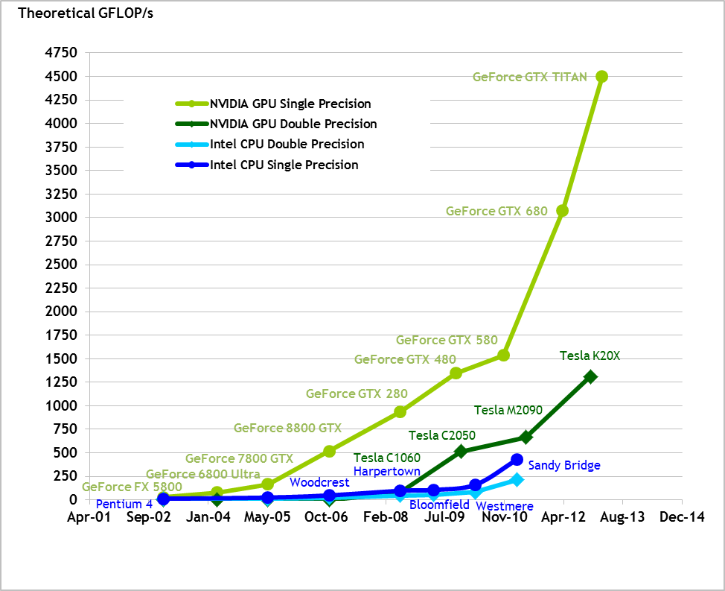
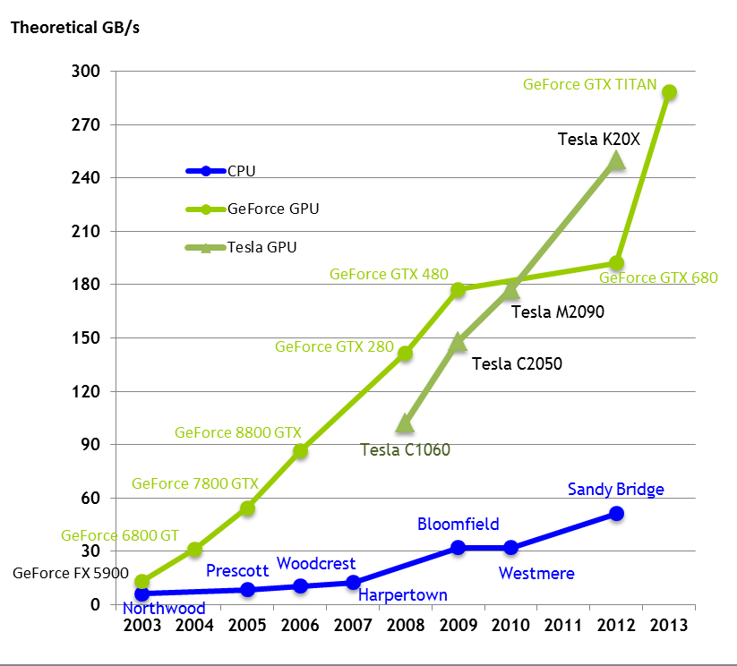
Why GPUs?
Images courtesy of NVidia
Massive parallelism
High GFLOP/sec
Fast Memory
Notes:
Since the early 2000’s frequency scaling is no longer an option
Parallelism is mandatory to continue with Moore’s law.

Slide 6
How to Target GPUs?
CUDA
Widely used
OpenCL Language
Functional portability (CPUs and GPUs)
Similar model as CUDA

Slide 7
GPU Memory Model
Notes:
GPU loads memory in 128byte segments. Align on those for best register density.

Slide 8
Target: GPU Cluster
Keeneland Initial Delivery (KID) System
360 NVidia M2070
240 CPUs, 12 threads each
Cascade
32 NVidia M2070
8 NVidia K20

Slide 9
Multi-GPU Concerns
How to partition and distribute our problem?
Faster computation increases relative cost of communication. Can it be amortized/hidden?
Multi-GPU OpenCL requires device ←→ host copies. Can they be hidden?

Slide 10
What is an RBF?
A radially symmetric function centered at
Notes:
Note the support parameter

Slide 11
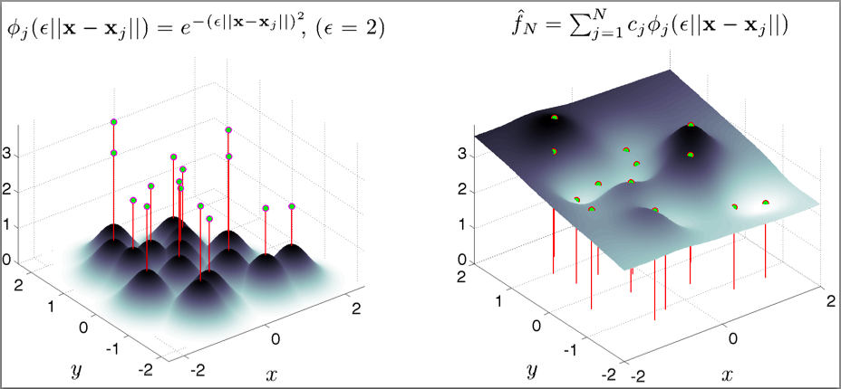
RBF-Interpolation
Notes:
Arise by enforcing

Slide 12
Pros/Cons of RBF Methods
Pros
Function the same in any dimension
Operate on unstructured meshes
High order convergence
Large time-steps
Cons
Support parameter,
Uncertainty Relation (Schaback, 1995)
Can be overcome with RBF-QR (Fornberg and Piret, 2007), RBF-GA (Fornberg, Lehto and Powell, 2013)

Slide 13
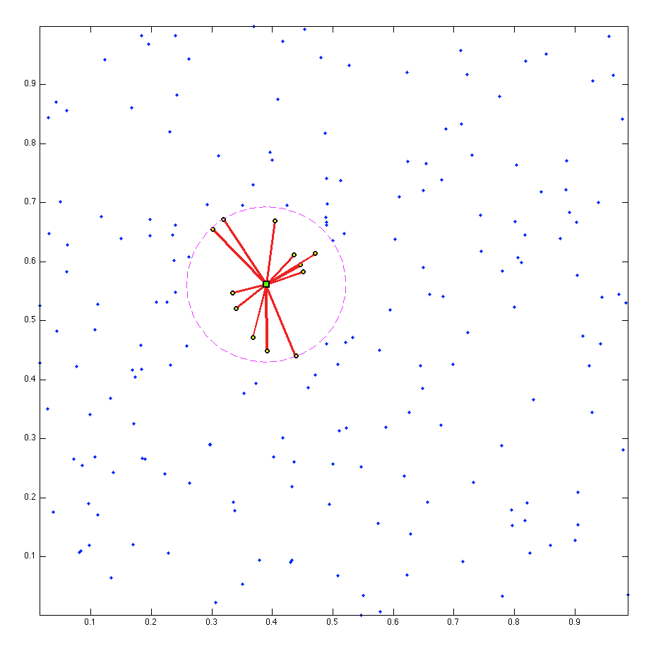
Stencils

Slide 14
RBF-generated Finite Differences (RBF-FD)
Classical FD (1-D*):
*Nonsingularity lost in 2-D; compose weights across dimensions
RBF-FD (d-D):

Slide 15
Differentiation Matrix
Sparse Matrix
n nonzeros per row (stencil size)
Unsymmetric (unique weights per row)
Sparse Matrix Vector (SpMV) multiply to get derivative across full domain

Slide 16
Multiple Linear Operators
Solve for weights with LAPACK dgesv or other efficient direct solver
Analytically apply operators to the RBF or compose operators like classical FD

Slide 17
Some Weight Operators
First and Second Derivatives:
Cartesian Gradient:
Cartesian Laplacian:

Slide 18
RBF-FD for Time-Dependent PDEs
Assume an input grid is provided.
We focus on stencil generation, decomposition and the Application Phase.

Slide 19
Related Work on Multi-GPU
Notes:
RBF OpenMP: \cite{Kosec2008} happy with 1.85x speedup using two cores
RBF MPI: \cite{Divo2005, Divo2007, Ingber2003,Ingber2004,Yokota2010}
Divo and Kassab: 10 compute nodes, then 36. Solving conjugate heat transfer problems.
Ingber: 3D diffusion equations up to 64 nodes
Yokota: RBF interpolation as component of PDE solve
RBF CUDA: \cite{Schmidt2009a,Schmidt2009b,Gumerov2007a, Gumerov2007b}
Schmidt global rbf collocation (dense matrix)
Gumerov rbf interpolation inside FMM method (dense matrix)

Slide 20
Verification
Hyperbolic form
Hyperviscosity

Slide 21
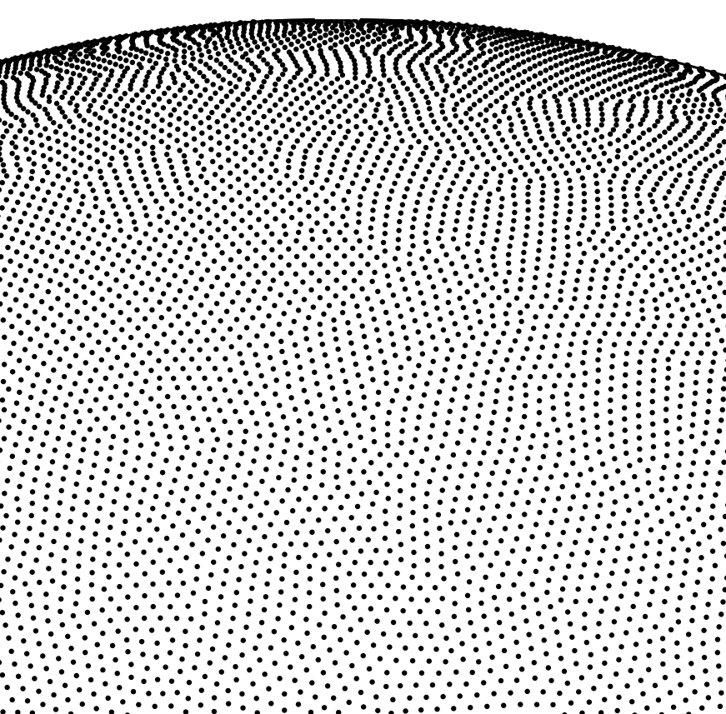
Grids on Unit Sphere
Icosahedral (Geodesic) Grid
Spherical Centroidal Voronoi Tessellation
Maximum Determinant (MD)

Slide 22
Hyperviscosity
Function
Terms
Scaling

Slide 23
Cosine Bell
Formula, Input, Solution

Slide 24
Cosine Bell Convergence
(left) HV parameter table
(left bottom) Eigenvalue before and after tiles
(right) Convergence plot

Slide 25
Vortex Roll-Up

Slide 26
Neighbor Query

Slide 27
kD-Tree

Slide 28
Fixed Grid

Slide 29
Fixed Grid Improvements

Slide 30
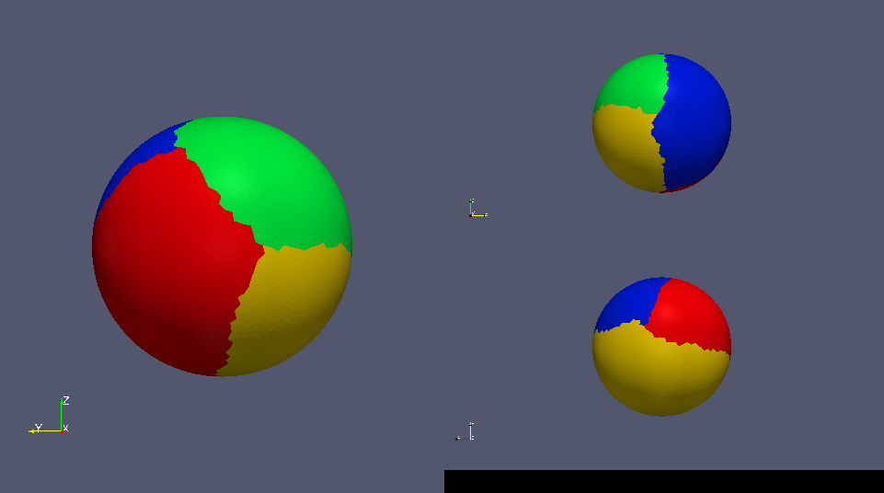
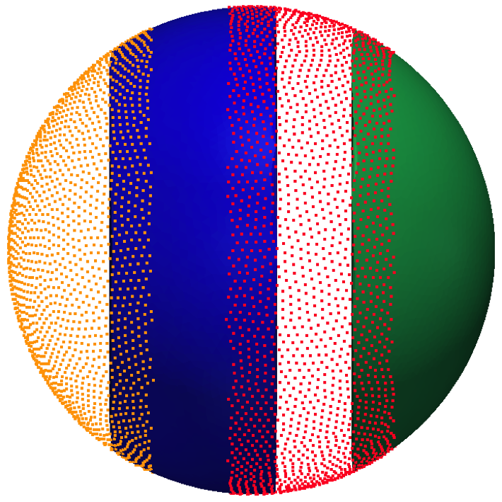
Domain Decomposition
Restricted Additive Schwarz Method
Graph partitioning with METIS for load balancing (Karypis and Kumar, 1999)
Requires symmetric adjacency matrix:

Slide 31
Load Balancing with METIS
Load balancing impacts parallel gains:

Slide 32
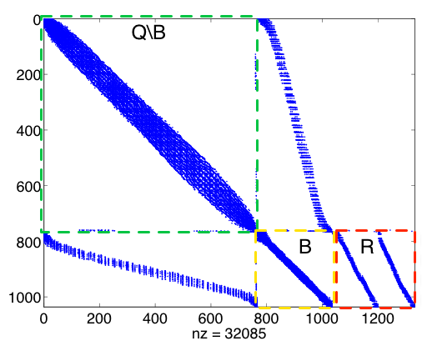
Node Ordering and Index Sets
Local Index Space
Global Index Space

Slide 33
Data Movement for Multi-GPU

Slide 34
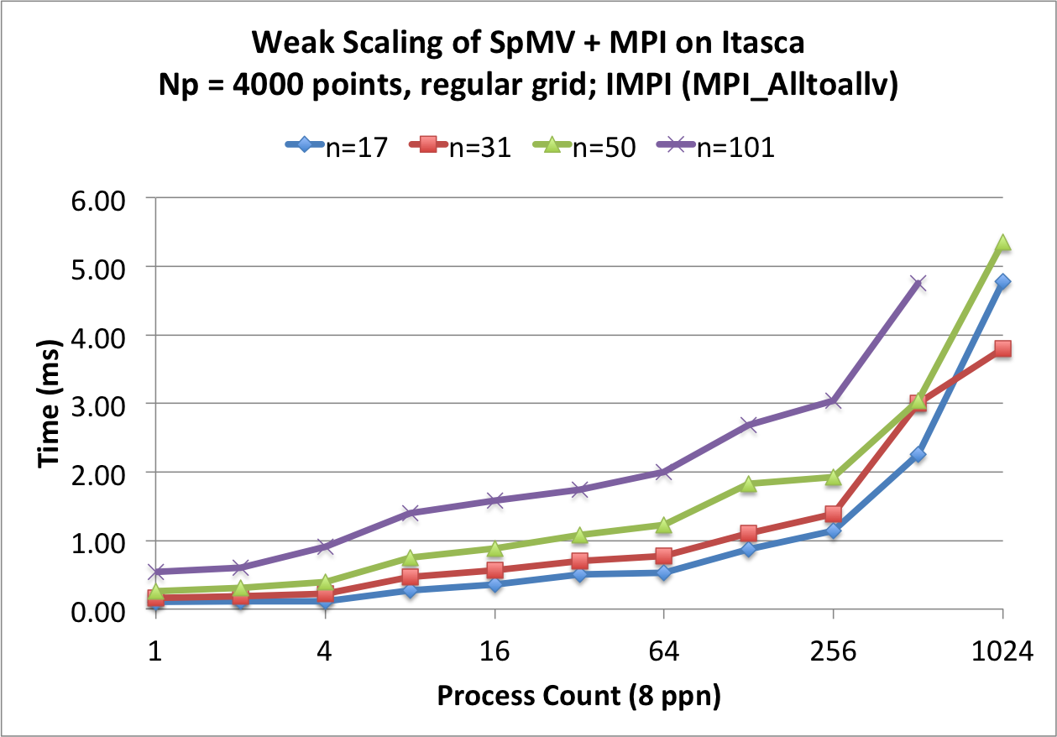
Multi-CPU Weak Scaling
Tuned on Itasca (UMN)
1,134 HP ProLiant blade servers
2x quad-core Xeon 5660 (“Nehalem EP”) processors per node
N=160³ nodes
Impact on performance for fixed problem size per processor
BEFORE (MPI_Alltoallv)

Slide 35
MPI Stages

Slide 36
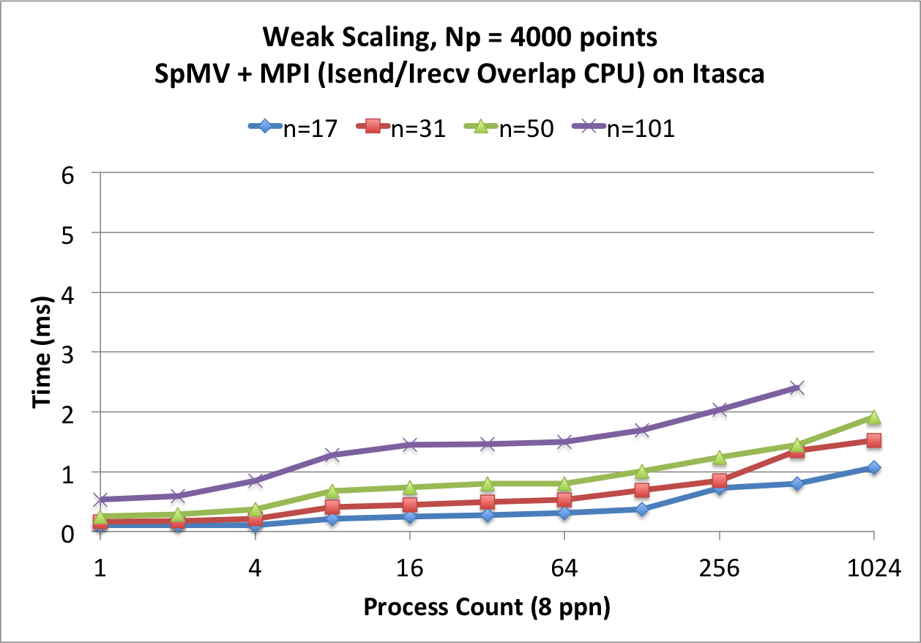
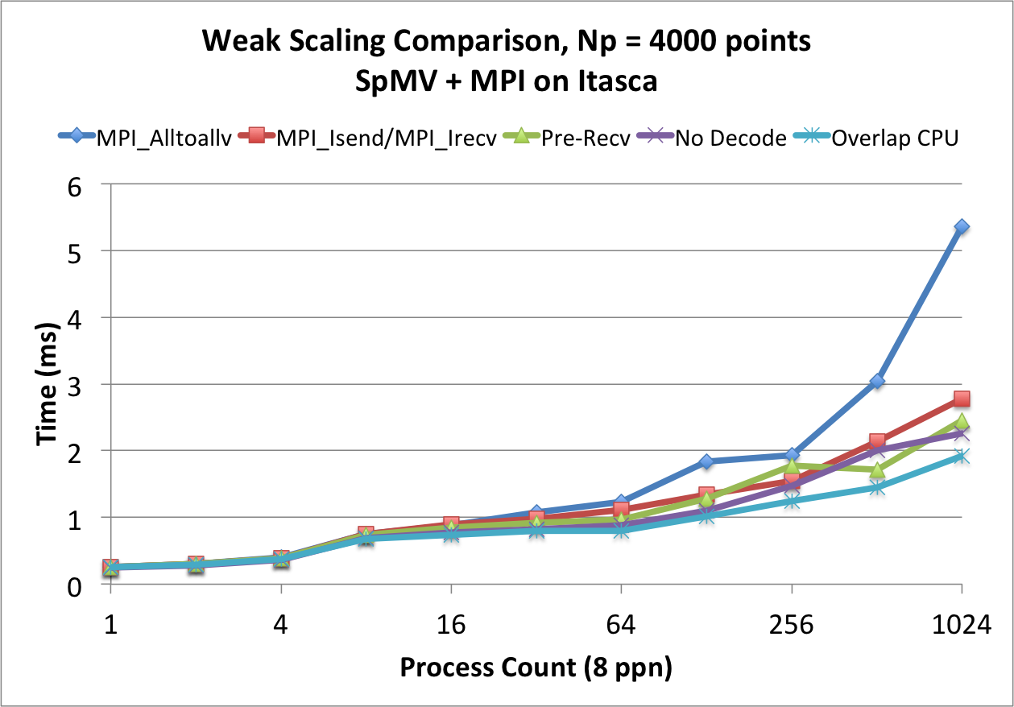
Multi-CPU Weak Scaling
2x-5x improvement at p=1024 processors
Larger N_{p} per processor would hide growth
METIS load balancing fails for p=1024, n=17:
AFTER
TUNING STEPS

Slide 37
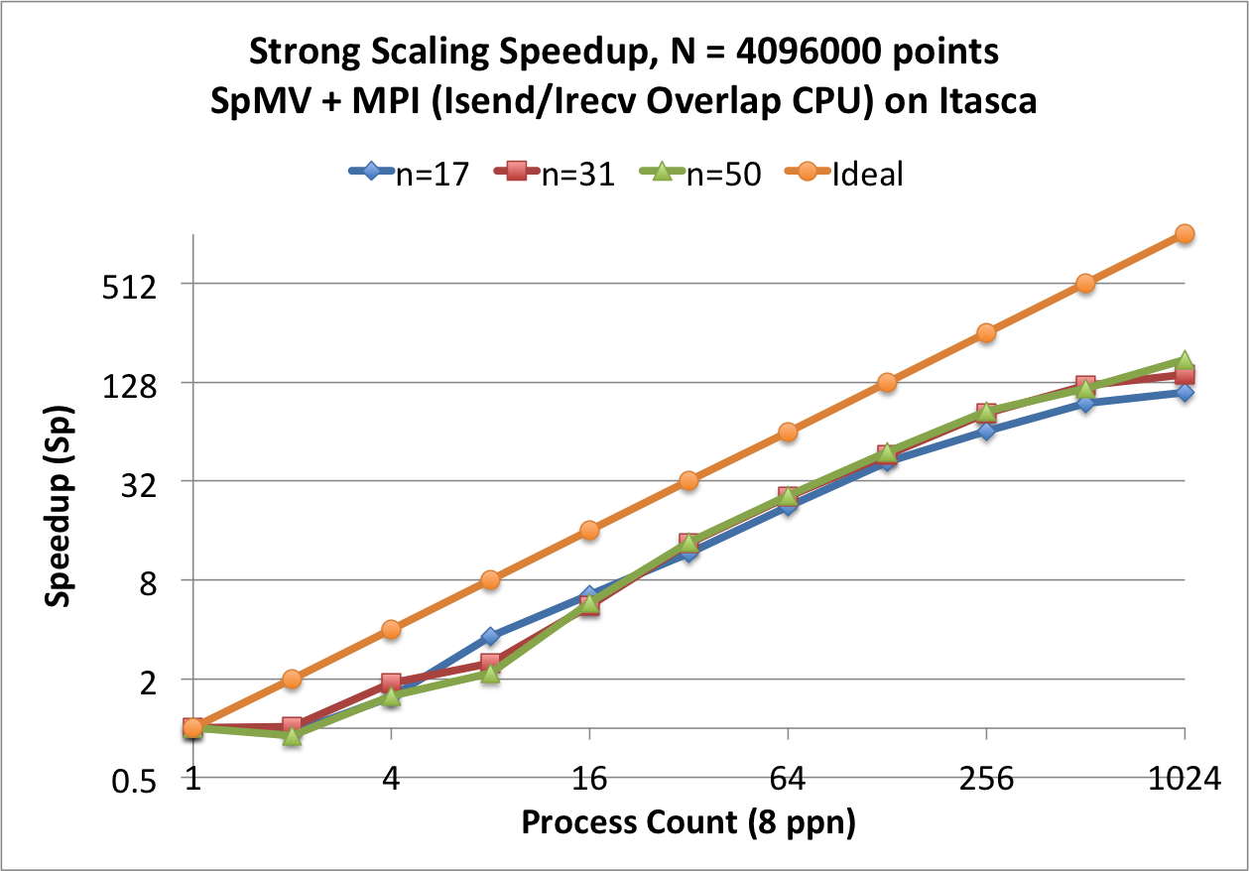
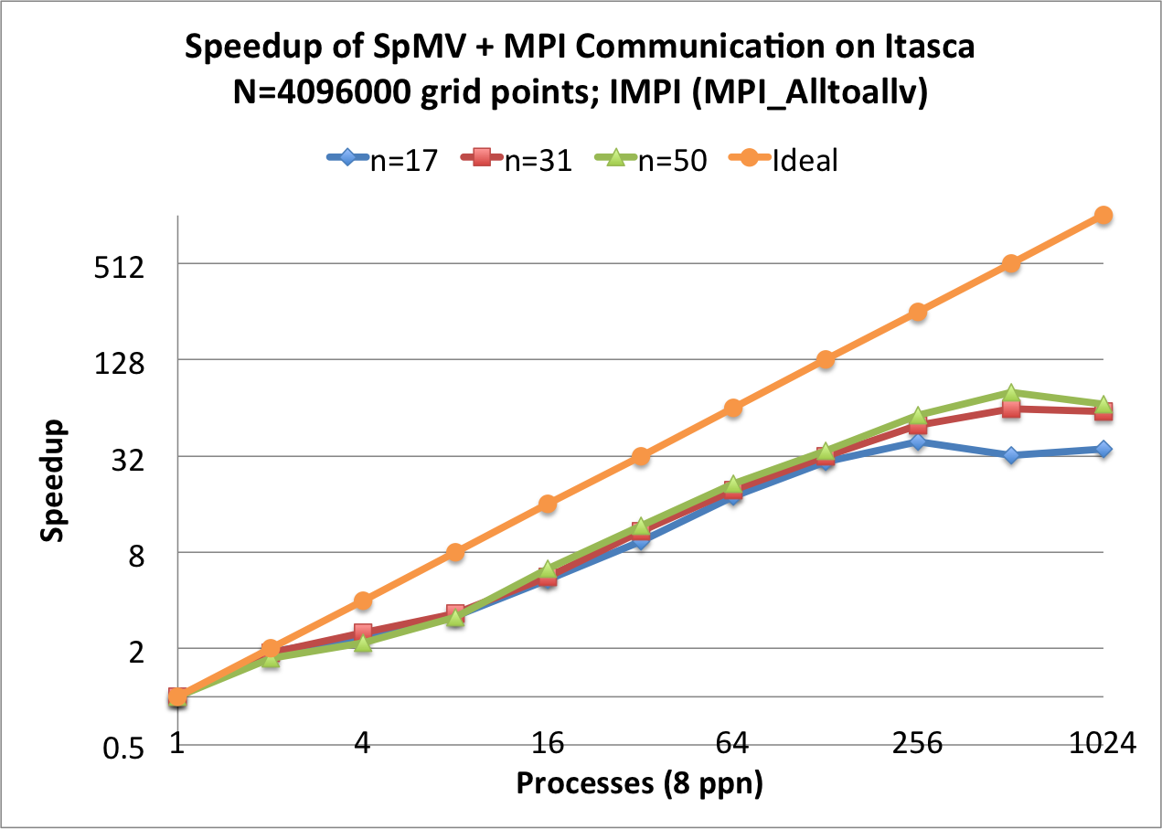
Multi-CPU Strong Scaling
Fixed global problem size with decreasing workloads
MPI_Alltoallv is 2x faster when operating on one node. Slower otherwise.
Near linear (ideal) scaling.
BEFORE
AFTER
Notes:
2-way fat-tree network
8 cores is a leaf and communicate via shared memory.
Groups of 16 nodes connect via QDR InfiniBand to \emph{leaf switches} at the second level of the tree.
All leaf switches are in turn connected to two director nodes via 4x QDR InfiniBand.
The topology exhibits 8:1 contention between nodes of the same leaf and additional 2:1 contention between leaf switches \cite{ItascaTuning}.
Our implementation of RBF-FD does not detect or adjust to network topology, so network contention may inflate communication times. Tuning for the network topology is reserved for future work.

Slide 38
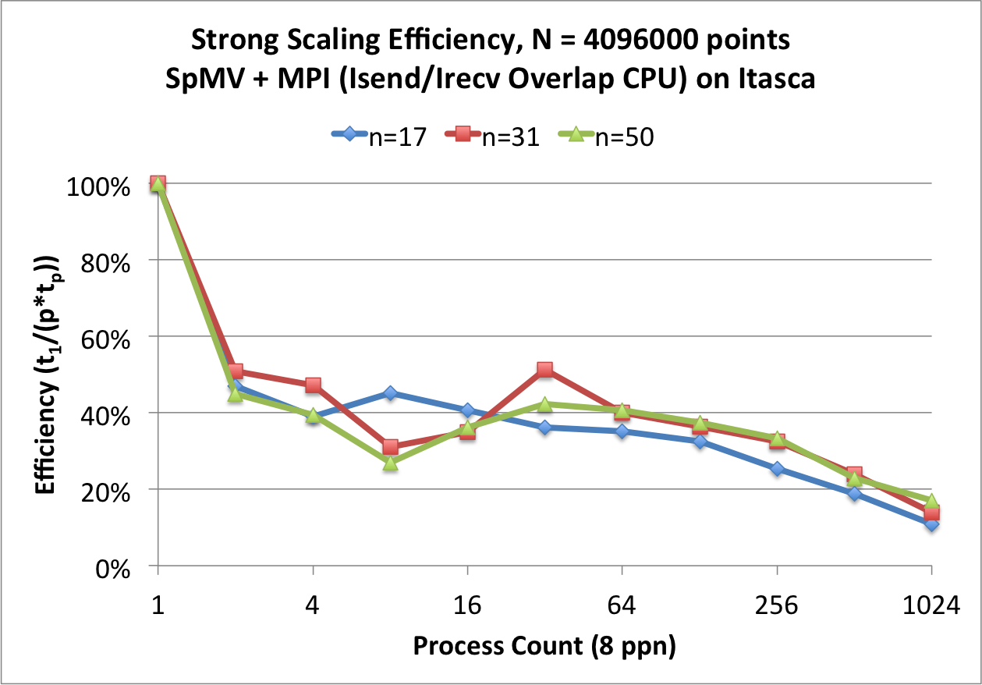
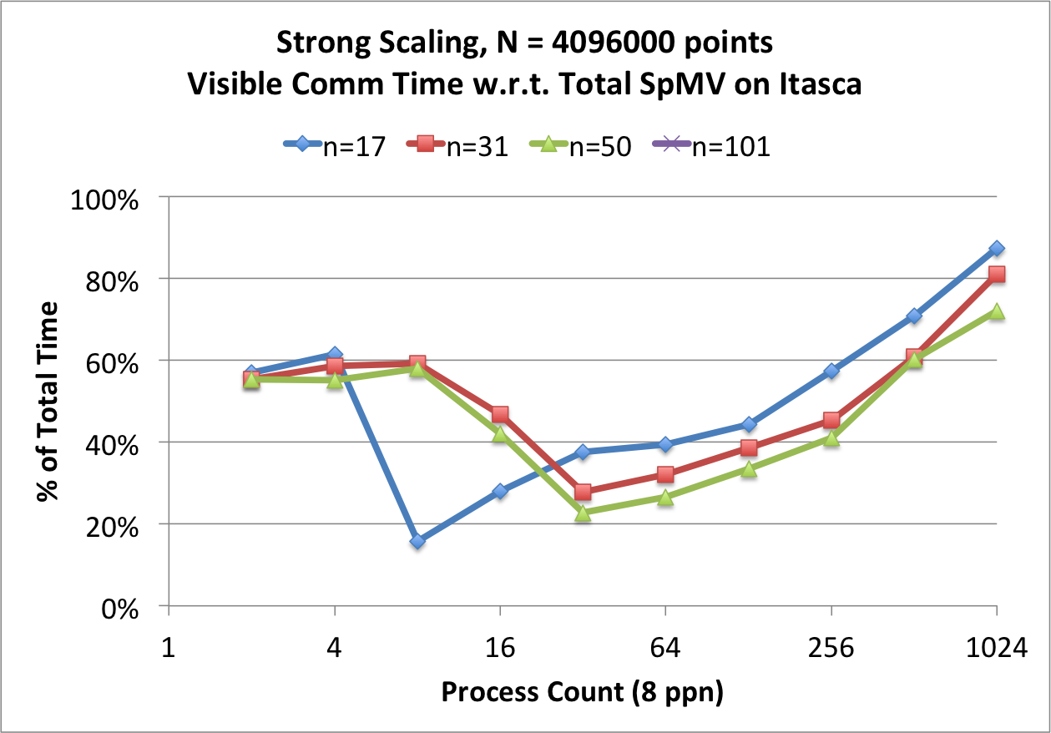
Strong Scaling Efficiency and Communication Overlap
Efficiency:
Visible Communication Time:

Slide 39
Multi-CPU Summary
Strong scaling
Scales well aside from effects of contention IB network and insufficient problem size for large p.
Weak scaling
Code scales well for small stencil sizes.
Larger N_{p} necessary to hide increasing cost of communication.
Future work:
Align messages properly for best performance
Possible FMM approach to limit communication between subddomains (Yokota et al. 2010)

Slide 40
Why use the GPU?
Performance success stories from Kepler/Fermi
High TFLOP/sec count

Slide 41
OpenCL
Comparison to CUDA
Functional Portability
Work items, work-groups, NDRange (NVIdia OpenCL manual)

Slide 42
OpenCL vs CUDA
Diagram from Prospectus comparing hardware levels

Slide 43
Custom Kernels
RK4 design
Eval + Advance
Input to each kernel

Slide 44
Vortex Performance (Keeneland)

Slide 45
Cosine Bell Performance
Adds one SpMV operation, but does not double performance. Question is why?

Slide 46
Roofline Model
The roofline model predicts MAXIMUM possible performance based on the operational intensity
SpMV is only OI(1/4)

Slide 47
How do we improve Memory-Bound Applications?
More memory compression
ELL format
BELL, SELL, SBELL
Fewer memory loads
Ordering
Register packing (non-zero condensation)
More operations (cite Erlebacher, Saule, Flyer, Bollig)

Slide 48
Memory Compression (Format Comparison)
Figure comparing formats
Give expressions for the number of memloads

Slide 49
Performance Comparison
N=50 format comparison figure
ELL comparison figure
Any data to compare to in related work (Rupp?, clSpMV)

Slide 50
Future Improvements for Single GPU
clSpMV formats show potential to get 50+GFLOPs when running in single precision
What is the translation to double precision (FERMI and K20)

Slide 52
Performance Portability? Intel Phi
High level intel phi architecture diagram
Achieved

Slide 53
Intel Phi Comparison
Achieved GFLOP/sec on Intel Phi

Slide 54
Performance Expectations for the GPU

Slide 55
Achieved Performance
Cosine Bell and Vortex Roll-up

Slide 56
SpMV Optimizations
VCL Data

Slide 57
Overlap

Slide 58
Limitations of I/O Hubs

Slide 59
Achieved GFLOP/sec

Slide 60
Conclusions

Slide 61
Community Outreach

Slide 62
Current and Future Work
Return to CUDA
CUDA v5.5 features supports MPI with GPUDirect®
SpMV Improvements:
Auto-tuned kernels with clSpMV (Su and Keutzer 2012)
New formats:
BELL, SELL, SBELL (Su and Keutzer 2012)
ELLPACK-R, pJDS, etc. (Kreutzer et al. 2012)
Applications with Multi-Matrix SpMM (Erlebacher et al. 2013)
Multiple subdomains per GPU (to saturate Fermi and Kepler cards and overlap computation)

Slide 63
Continued and Future Work II
Intel Phi vs NVidia Kepler
Latest hardware from Nvidia?
Multi-GPU preconditioned GMRES solutions of RBF-FD for Stokes flow
Core operation of GMRES: SpMV
Current work is incomplete
with RBF-GA

Slide 64
Questions?
Remember: this is research. If we had all the answers we wouldn’t be doing it.

Slide 67
Extras

Slide 68
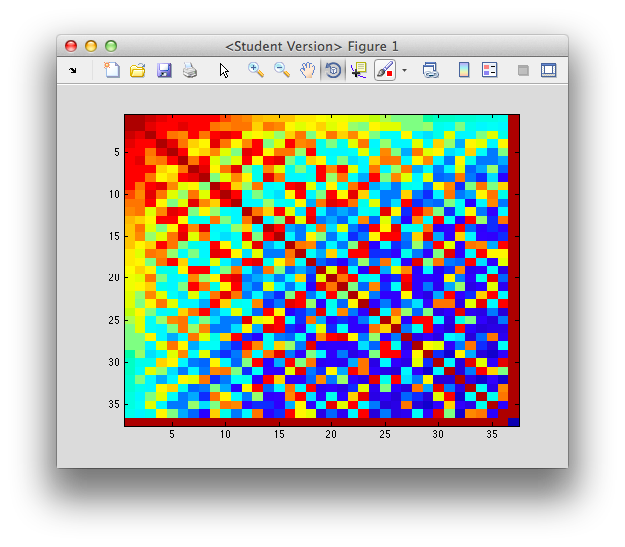
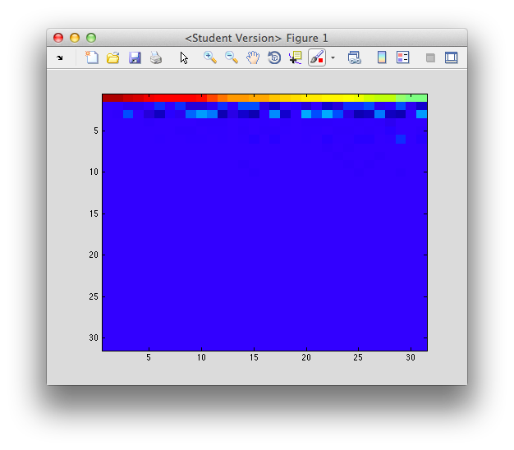
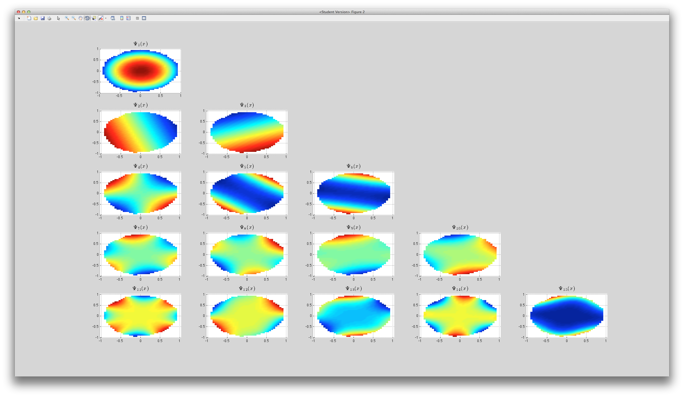
RBF-GA (Preliminary Results)

